Slide 1

THE STRUCTURE, CONDUCT AND PERFORMANCE OF MAIZE MARKETS IN MALAWI
Preliminary Findings
Dennis Ochieng and Rosemary Botha
IFPRI Malawi
IFPRI-Lilongwe | 09/10/2018

Slide 2

Background
  Maize is life’ in Malawi (Smale, 1995)
  Maize contributes to 66% of calories in typical diets
  Maize production is largely by smallholder farmers
  ‘ Large’ farmers mainly focus on seed
  Maize market is key to food security and poverty reduction in Malawi (Jayne, Sitko, Gilbert & Mangisoni, 2008)
  Food price dilemma
  ‘Food prices are too high, farmgate prices are too low’
  (Timmer, Falcon and Pearson 1983)
Notes:
Large-scale farmers only allocate 6% of total lands to non-seed maize production (Edelman et al., 2016).
Jayne et al study was done for DFID (but fieldwork concentrated on central Malawi)

Slide 3
Objectives of the SCP Study
To describe the structure of the maize market: i.e., in particular the channels through which maize flows from farmers to consumers
To examine the conduct of maize value chain actors, and the interplay of policy interventions and maize marketing
To examine perceptions of maize value chain actors of the maize market and how the perceptions influence maize market performance
and to
To analyze maize price dynamics, farm gate-retail margins to understand sources of volatility in maize volumes/prices and now to boost maize sector growth
To triangulate the estimates of maize production and consumption from various data sources and examine computational sensitivity of food balance sheets and their implications
To analyze the level of spatial integration of maize markets within and across regions

Slide 4
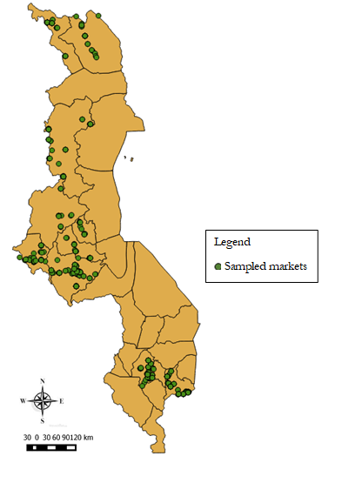
Data and Methods
A mixed method approach was employed, with semi-structured interviews of 555 traders and 28 focus group discussions (FGDS) of maize farmers
The fieldwork covered:
7 districts and 14 Extension Planning Areas (EPAs) from Mulanje in the South to Chitipa in the North
2 EPAs per district, 2 FGDs per EPA, 15 farmers per FGD (of mixed gender and ages)
Figure 1. Map of the study area (April – July 2018)

Slide 5
Data and Methods (cont…)
Data sources
Primary data: trader survey and FGDs + 2 household surveys (IHS4 and Pluralistic extension survey)
Secondary data: prices (IFPRI, mVAM); production and consumption (MoAIWD), informal imports /exports (FEWS NET), post harvest losses (existing literature)
Analytical approaches
Descriptive statistics – market concentration, price movements, farmgate-retail price margins
Quantitative analysis – market performance – margins, price volatility, market integration (using threshold error correction model with transfer costs)
          – Maize availability (Unofficial food balance sheet by IFPRI)
Qualitative analysis – transcripts of 28 FGDs (to be analysed using nVivo)

Slide 6
Findings: Structure and conduct of the maize market
Notes
NFRA contracted AHCX to aggregate 32000MT of maize to replenish SGR
Government to distribute relief maize through ADMARC
ADMARC began buying maize from late August 2018
Limited sales through commodity exchanges (commex) –just 1.3% of traders sold through Comex during the season
Figure 2. Maize marketing channels during main marketing season (April – July 2018)

Slide 7
Findings: Structure and conduct (cont …)
Perceptions of farmers/traders/ADMARC/trade policy
Maize market:
  Farmers are price takers
  Limited market opportunities beyond farm gate
  Distress sales
  Prices observed were MWK 30 – MWK 65/kg lower than minimum farm gate price
Traders (small, medium and large)
  Set prices in both rural and urban markets
  Depress prices during harvest periods and inflate prices in the lean seasons
  Alternative to outlet beyond assemblers and ADMARC
  Beneficiaries of ADMARC market
  Inaccurate scales of the traders leading to quantity losses
ADMARC:
  Delays in opening depots costs farmers a lot
  Higher quantities requirement exclude SHFs from supplying ADMARC
  ADMARC serving interests of traders more than farmers
  ADMARC scale are inaccurate, leading to losses of about 10kg per 50kg bag of maize
Trade policy:
  Trade restrictions (i.e. export bans, other restrictions) create market uncertainties which discourage maize production and trading
Notes:
Packed slide: split into 2

Slide 8
Policy environment: i) Trade restrictions (i.e. export bans, other restrictions) create market uncertainties that stifle growth of maize sector, ii) Trade bans are counterproductive expands informal maize imports/exports.
Iii) Trade restrictions create maize volume and price volatility iv) Relief food distribution distorts markets – disincentivizes traders.
Findings: Structure and conduct (cont …)
Maize market:
  Unpredictable marketing environment (policy changes)
  Large private traders set prices
  Intense competition among small and medium scale traders but less among large traders
  limited market opportunities beyond large traders and ADMARC
ADMARC:
  Delays in opening depots costs traders a lot
  Higher quantities requirement exclude small traders from supplying ADMARC
  ADMARC market scales are inaccurate, leading to quantity losses of about 10kg per 50 kg bag
Large private traders
  Set prices in both rural and urban markets
  Depress prices during harvest periods and inflate prices in the lean seasons
  Alternative to outlet beyond assemblers and ADMARC
  Beneficiaries of ADMARC market
Notes:
This is a very busy and packed slide - -split into 2

Slide 9
Findings: Structure and conduct (cont …)
Notes:
This is a very busy and packed slide - -split into 2

Slide 10
Findings: Structure and conduct (cont …)
Concentration of maize market
83 % of the traders earn less than MWK 5 million
Only a few traders have relatively higher incomes
Wide variation in the scale of operation of different market actors
Figure 5 Pen’s parade of sales value by trader types

Slide 11
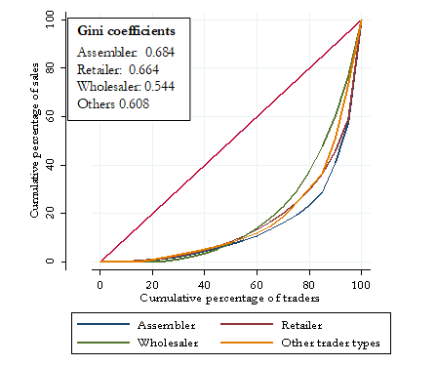
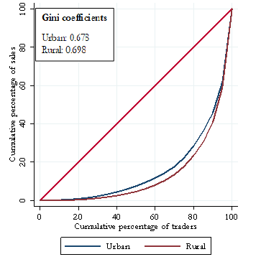
Findings: Structure and conduct (con’t …)
Concentration of maize market –Lorenz curves
Inequality in revenues among traders
High inequality among all trader types in the market – greater deviations of the sales incomes from the line of equality
Rural vs Urban
High inequality among rural and urban traders– greater deviations of the sales incomes from the line of equality

Slide 12
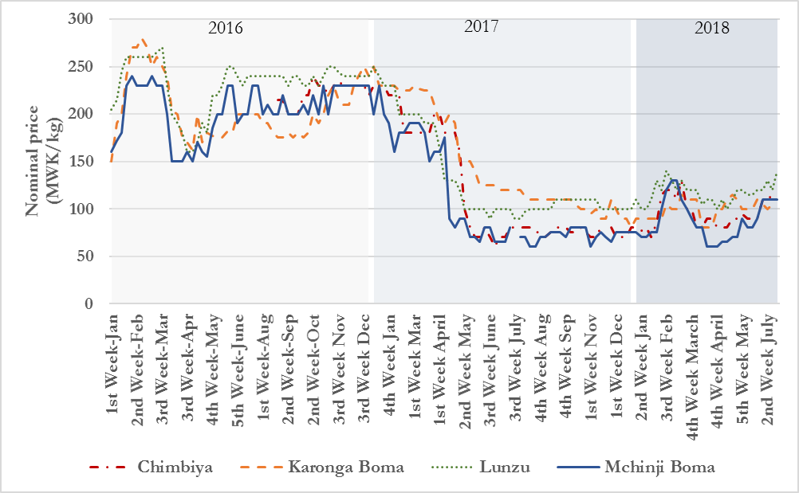
Findings: Performance of the maize market
Price movements, 2016 to 2018
Maize retail prices have been volatile over the past three years
Prices in 2016 were higher than in subsequent years
Prices were lower at the onset of harvest seasons and higher at the peaks of lean seasons
Figure 7 Price movements in selected markets in Malawi
Source: Authors’ estimates from mVAM data

Slide 13
Findings: Performance (cont …)
Farm gate- retail margins
Wide farm gate-retail margins in the selected districts ranging between 13 to 65% from farm gate price
Farm gate prices were lower than the minimum farm gate price announced by MoAIWD in mid April
Table 1 Farm gate-retail margins during main marketing season (2018)
District | Farm gate | Retail | Difference (%)
Lilongwe | 97.61 | 120.33 | 23.27
Mchinji | 77.34 | 120.00 | 55.16
Salima | 117.50 | 135.33 | 15.18
Dedza | 95.35 | 111.67 | 17.12
Blantyre | 120.00 | 135.67 | 13.06
Mulanje | 83.00 | 136.67 | 64.66
Thyolo | 94.62 | 137.33 | 45.15
Chikwawa | 104.12 | 128.33 | 23.25
Nsanje | 100.00 | 131.00 | 31.00
Interpretation
Price transmission is slow between farmgate and retail points of sale
Markets were not well integrated
Source: Survey (2018)
Notes: Farm gate prices were obtained from the national extension survey (July-September 2018); Retail prices were obtained from IFPRI daily retail maize price repository; Prices are only reported for the districts that IFPRI collects daily retail price data.

Slide 14
Findings: Performance (cont …)
Price volatility
Maize retail prices were generally volatile as shown by the coefficient of variation
Highest price variation in the northern region
Maize retail prices were higher in the southern/northern markets and lower in central markets
Lunzu and Rumphi recorded the highest average price
Table 2 Average real retail maize prices (2010=100)
Market | Mean | SD | CV | Range
North
Karonga | 49.9 | 18.05 | 0.36 | 23.07 – 67.42
Rumphi | 50.97 | 19.56 | 0.38 | 20.51 – 70.25
Mzimba | 44.33 | 18.52 | 0.42 | 17.09 – 68.88
Mzuzu | 44.09 | 16.19 | 0.37 | 18.59 – 69.61
Centre
Chimbiya | 39.27 | 13.67 | 0.35 | 18.20 – 63.75
Mchinji | 44.27 | 15.15 | 0.34 | 19.50 – 64.85
Mitundu | 45.84 | 15.68 | 0.34 | 18.33 – 71.32
South
Liwonde | 42.29 | 13.51 | 0.32 | 20.95 – 70.83
Lunzu | 50.97 | 16.03 | 0.31 | 21.60 – 70.35
Mulanje | 48.19 | 14.21 | 0.29 | 26.19 – 73.28
Mwanza | 42.92 | 11.63 | 0.27 | 27.37 – 78.16
Chikwawa | 45.46 | 14.19 | 0.33 | 23.57 – 71.81
Nsanje | 40.37 | 12.66 | 0.31 | 26.49 – 69.23
Source: Authors’ calculations

Slide 15
Findings: Performance (cont …)
Spatial Market integration (threshold error correction model)
Within-region integration
Integrated markets pairs: Mchinji-Chimbiya; Karonga-Mzimba; Lunzu-Mulanje
Even within the same region, markets that were near to each other were not well-integrated i.e.. Mchinji-Mitundu
Between-region integration
Integrated market pairs: Mzimba-Mchinji, Mzimba-Chimbiya, and Mchinji-Lunzu
Takes 3 to 50 days for prices to adjust to long-run equilibria
Interpretation
Maize markets in Malawi are poorly integrated and slow price transmission between locations
The process of price adjustments was slower between-regions than within-regions

Slide 16
Findings – Performance (cont…)
Maize availability
UNOFFICIAL MALAWI NATIONAL FOOD BALANCE SHEET, 2018-19
Adapted from methodoly in IFPRI Assessment of FIRP 2016-17 Report
ITEM | MAIZE | RICE | SORGHUM/MILLET | WHEAT | MAIZE EQUIVALENT
A. DOMESTIC SUPPLY | 3,000,712 | 88,132 | 106,222 | 656 | 3192920
NET PRODUCTION | 2,409,277 | 82,101 | 100,239 | 656 | 2589571
Gross Production | 2,697,959 | 112,313 | 114,167 | 729
Post-harvest losses (%) | 10.7% | 26.9% | 12.2% | 10.0%
OPENING STOCKS (Carry Over Stocks) | 591,435 | 6,031 | 5,983 | 0
On-farm stocks | 172,435 | 6,031 | 5,983
SGR (physical stocks in silos) | 192,500 | 0 | 0
ADMARC | 76,500 | 0 | 0
Private traders | 150,000 | 0 | 0
kilocalories/kg | 3,560 | 3,630 | 3,430 | 3,390
B. TOTAL UTILISATION | 3,102,371 | 106,090 | 65,652 | 91,310 | 3273802
Food Use | 2,760,265 | 102,075 | 64,816 | 91,310
Seed Requirement | 42106 | 4015 | 836
SGR Replenishment | 200,000 | 0 | 0
Feed and Industrial Uses | 100,000 | 0 | 0
C. DOMESTIC BALANCE | (101,658) | (17,958) | 40,569 | (90,654) | -80882
H. TOTAL IMPORTS | 12,000 | 6,000 | 1,500 | 175,913
Formal Imports | 0 | 3,500 | 500
Informal Imports | 12,000 | 2,500 | 1,000
Food Aid Imports | 0
I. TOTAL EXPORTS | 3,000 | 6,000 | 4,500
Formal Exports | 0 | 1,000 | 1,500
Informal Exports | 3,000 | 5,000 | 3,000
Food Aid Exports
J. NET IMPORTS | 9,000 | 0 | (3,000) | 175,913
SURPLUS/DEFICIT | (92,658) | (17,958) | 37,569 | 85,259
F. CROSS SUBSTITUTION | 99,074 | (18,312) | 36,197 | 81,188
K. TOTAL FOOD SURPLUS | 6,415 |  |  |  | 6415
Food balance sheet using August 2018 production estimates (APES) with 10% post harvest losses (PHL) rate from MoAIWD
A maize surplus of 6,415MT + wheat estimates
A maize deficit of 74,722MT, without wheat estimates
Food balance sheet using August 2018 APES data at 5% PHL rate (Ambler et al., 2018)
Sufficient maize available
A maize surplus of 160,199MT
Interpretation
Food Balance sheet sensitive to PHL shocks and APES data
APES data and PHL rate need attention
Notes:
We do not have access to the official 2018 FBS

Slide 17
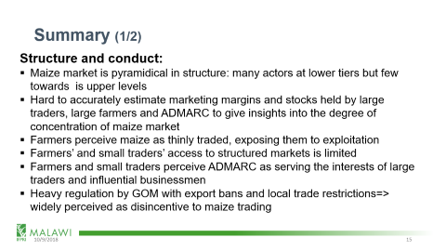
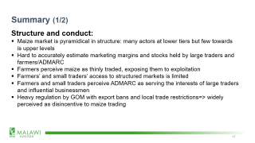
Summary (1/2)
Structure and conduct:
Maize market is pyramidical in structure: many actors at lower tiers but few towards is upper levels
Hard to accurately estimate marketing margins and stocks held by large traders and farmers/ADMARC
Farmers perceive maize as thinly traded, exposing them to exploitation
Farmers’ and small traders’ access to structured markets is limited
Farmers and small traders perceive ADMARC as serving the interests of large traders and influential businessmen
Heavy regulation by GOM with export bans and local trade restrictions=> widely perceived as disincentive to maize trading

Slide 18
Summary (2/2)
Performance
Maize market is imperfect with high price volatility
Wide farm gate-retail margins in many districts during the main marketing season => to dysfunctional marketing system
The maize market is characterized by intense competition at lower tiers but minimal competition at higher levels
The maize market is not transparent enough to facilitate planning of maize marketing to stabilize volumes and prices
Maize markets in Malawi are poorly spatially integrated =>slow price transmission from one location to another
Notes:
Part 2 of this slide

Slide 19
Policy Implications
Government should minimize (if not eliminate) discretionary policy interventions that restrict and undermine incentives in the maize trade
This includes the minimum farm gate price system (which is non-binding)
Need to accelerate smallholder commercialization to expand maize productivity and marketed surpluses, coupled with effective post-harvest management practices
Need to educate smallholder farmers about existing structured trade opportunities
Upgrading road and telecommunication infrastructure in remote areas would facilitate timely and cheaper access to markets and market information
An open consultative fora that brings stakeholders together to promote information sharing would be desirable

Slide 20
Next Steps and Possible Extensions
Further analysis of strength of market integration and speed of price transmission within and across regions
Examining possible seasonal trade reversals between rural and urban markets of Malawi (this requires lean season survey)
Estimating annual maize production and consumption in Malawi
Estimating the least cost way to redistribute surplus maize from sufficient to deficit areas
Notes:
Need to mention our desir

Slide 21


Acknowledgements
This research was made possible with funding from the United States Agency for International Development and the UK Department for International Development

